Slide 1

Project Selection
A desire to complete our Team Vision from last semestral project
A brief on last project….
Notes:
Let me just kick off with our project selection. – It stemmed from our last semester’s project.
The team reviewed last semestral project and all agreed that we should finish off our unfinished Team Vision
Allow me to briefly run through our last project.

Slide 2
Project Title
In the light of Covid-19, how might customers feel safer while shopping through Smart Technologies? Case Study at DECATHLON Store
Last Project
Notes:
This was our project title. The project concept then was conceived to coincide with the Health Ministry task force on safe management measures.
We used Decathlon Store as our case study.

Slide 3
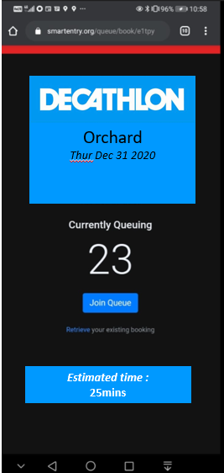
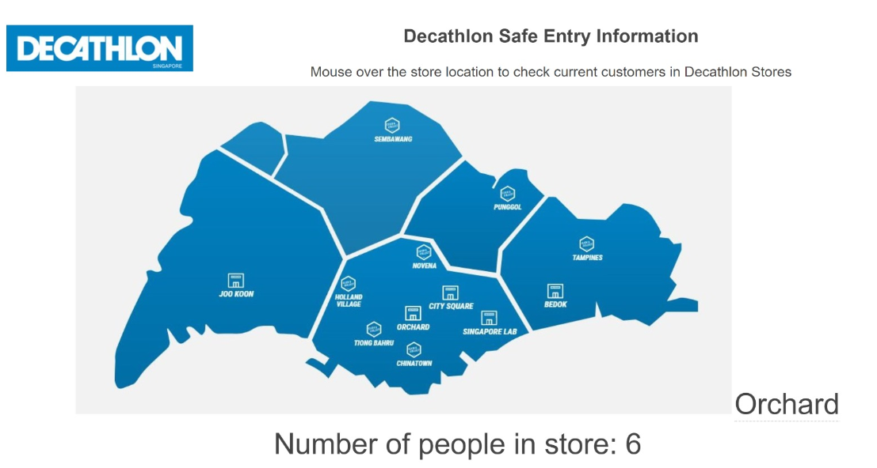
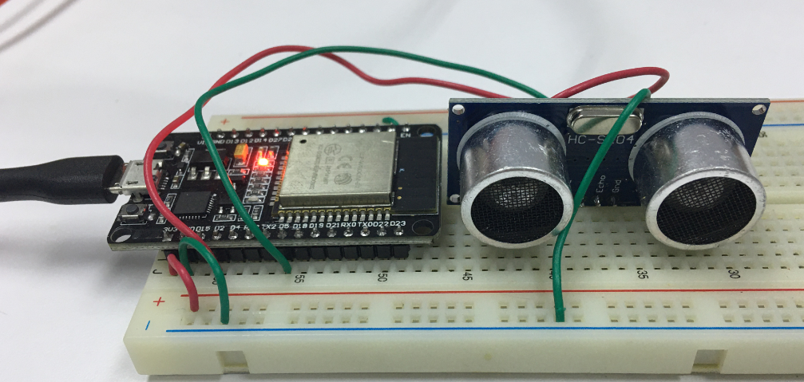
Team Vision
AWS
Net Customers Count
Book queue/SMS notification
Limited Sensors
Live update on web
EPS32 +
Ultrasonic Sensor
Notes:
In the safe management measures, one of the advisories is permit mega store like Decathlon to hold max customer capacity based on Gross Floor Area or GFA.
Our team undertook the vision to implement 3 applications satisfy smart technologies:
- sensors that track the number of customer in store
- upload, publish and display the info on the cloud
- provision a mobile app for customer to book and join queue instead of queuing outside store.
3. At end of project implementation, it was obvious here that we could managed 2 applications.

Slide 4
This semester…
To accomplish our vision by working on the remaining mobile app, and along with enhanced sensors to automate the SMM process
Notes:
But we save the best for last. Now that we are better equipped with mobile app programming knowledge, our team is determined to accomplish our unfinished vision.
And along with the knowledge learnt from the Sensor and Communication Technologies module, to further implement a suite of collective sensors to implement an automated safe management measures process.

Slide 5
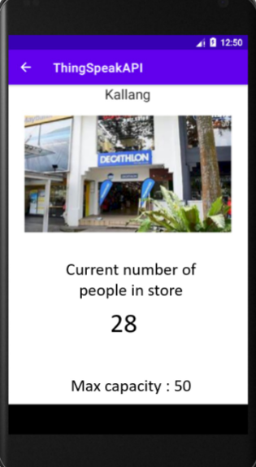
Operative Concept
Firebase
Crowd information
Book queue
SMS notification
Enhanced Sensors
Provision of Webpage on number of customers at various store locations
Automated for control entry access
Process customer count and upload to cloud
Notes:
This is the concept of operation.
The sensors are to provide automated entry access as well as to process the net customer count, upload and update the cloud.
The cloud provides a webpage on the number of customers at various store locations. It also store data for mobile app to draw the relevant info.
The mobile app provides information on the number of customers at various store locations and allow customer to book queue and be informed on the queue status via sms notification.

Slide 6
Design Thinking
Sense and Sensibility
Ideation
Empathy
Prototype*
Brainstorm solutions, select and develop solution
Clearly articulate the problem
Develop a deep understanding of the challenge
Enhance the prototype towards automation
Notes:
The Design Thinking tool help to validate the continuation of this project.
We reviewed the chain of processes, by and large we derived with the same outcome as the last project.

Slide 7





Design Thinking
Sense and Sensibility
The problem statement involves an end user, problem to be tackled and a probable solution.
Our project statement defined “how might customers feel safer while shopping through Smart Technologies? ”
2) Empathy - POEMS
P - People
Elderly customers
Impatient Customers
Confusion among staff
Customer with kids
Absence of signage for customer
Notes:
The next few slides are further details of our review

Slide 8





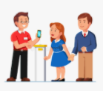
Design Thinking
O - Object:
Lack of queuing pole guide
E - Environment:
Aircon too cold, discomfort
Lack of 1-metre markers
M - Message/Media:
Unclear instruction
Lack of customer count in store
Lack of waiting time info
S - Services:
Ease customer frustration
Option to other outlets

Slide 9




Design Thinking
Insights/Observation
From POEMS we gain the insight/observation as follows:
Lack of signage / info / est. waiting time
Staff under pressure from customers
Oversight of exceeding occupancy limit

Slide 10
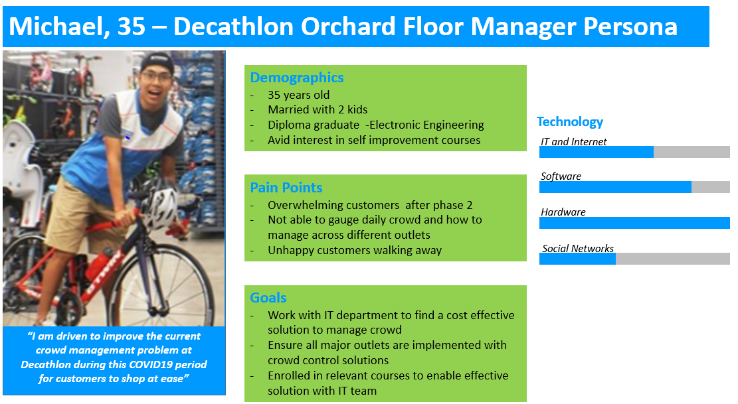
Design Thinking
c) Persona

Slide 11
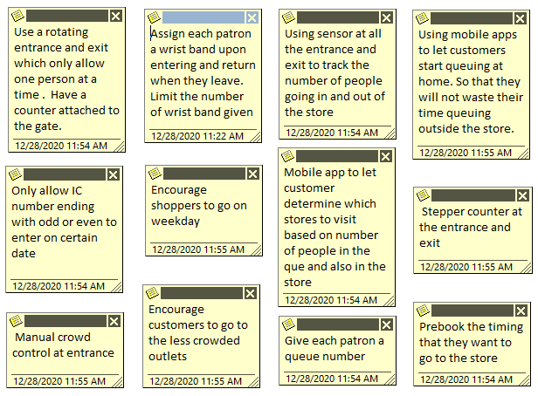
Design Thinking
3) Ideation
a) Brainstorming
After 15 mins of brainstorming below are the ideas generated:

Slide 12
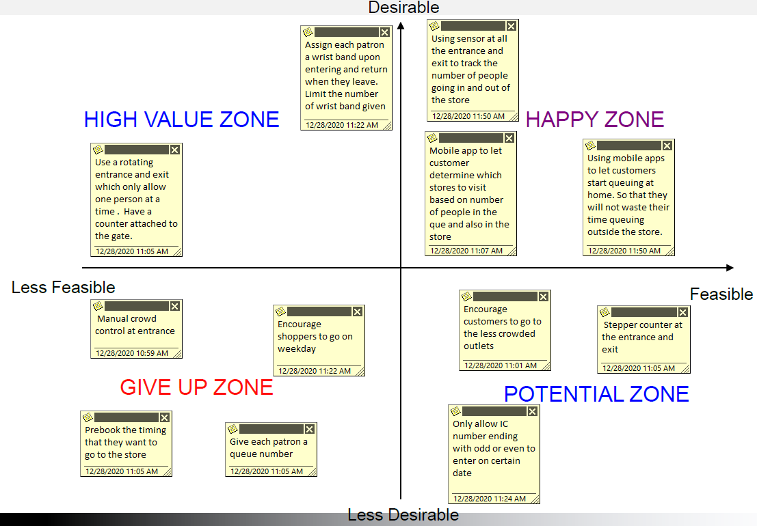
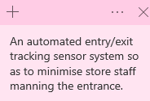
Design Thinking
b) Matrix Analysis
Using matrix analysis we narrowed down to three ideas that are both desirable and feasible:
Using sensors at all the entrances and exits to gather the number of people going in and out of the store, and upload to cloud
Sensor system to be automated, minimizing staff manning.
Mobile app to let customers determine which less crowded stores to shop based on the number of people in the queue (if any)
Using mobile app to let the customer book queue. This minimize large queue outside the store.
Data with current customers count from each of the 5 physical stores could be updated live to the cloud.

Slide 13
Project Title
Digital Solutions for An AUTOMATED Crowd Control Management @Decathlon
Notes:
1. With the Design Thinking tool, we not only arrived with the same goal of achieving crowd control management, and one with a fully digital and automated solution.

Slide 14
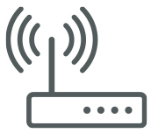
Decathlon Crowd Management System
Decathlon Mobile Apps
One module dedicated to SMM application on top of browsing catalogue.
Check crowd management status and book queue if needed.
Receive SMS notification.
Firebase Cloud
Mobile Apps for Info Retrieval/SM Notification
Wifi for update of net count
Entry Sensor
Exit Sensor
Arduino Uno
LoRa/Wifi/Bluetooth
Distance between entrance and exit points more than 100 m apart and blockage of AP
LoRa/Wifi/Bluetooth
LoRa for update of exit count
Obstacle Avoidance IR
Obstacle Avoidance IR
LCD
Counter
Entrance Arduino
Process net customer count from both entrance and exit and upload to cloud SQL.
Update and display counter on the no. of customers.
Control barrier for customer entry.
Ultrasonic Ranger
Exit Ardunio
Count customer exit and update Entrance Arduino for process.
LED
Warning
Buzzer
Warning
Servo

Slide 15

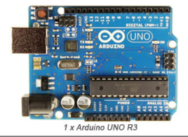
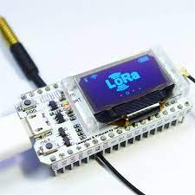
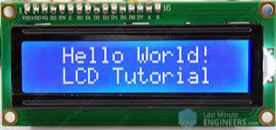
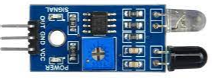
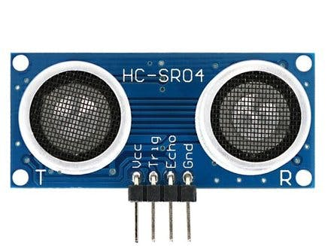

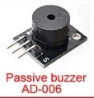
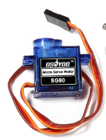
Decathlon Crowd Management System
Decathlon Mobile Apps
One module dedicated to SMM application on top of browsing catalogue.
Check crowd management status and book queue if needed.
Receive SMS notification.
Firebase Cloud
Wifi for update of net count
Entry Sensor
Exit Sensor
Arduino Uno
Distance between entrance and exit points more than 100 m apart and blockage of AP
LoRa for update of exit count
Entrance Arduino
Process net customer count from both entrance and exit and upload to cloud SQL.
Update and display counter on the no. of customers.
Control barrier for customer entry.
Exit Ardunio
Count customer exit and update Entrance Arduino for process.

Slide 16
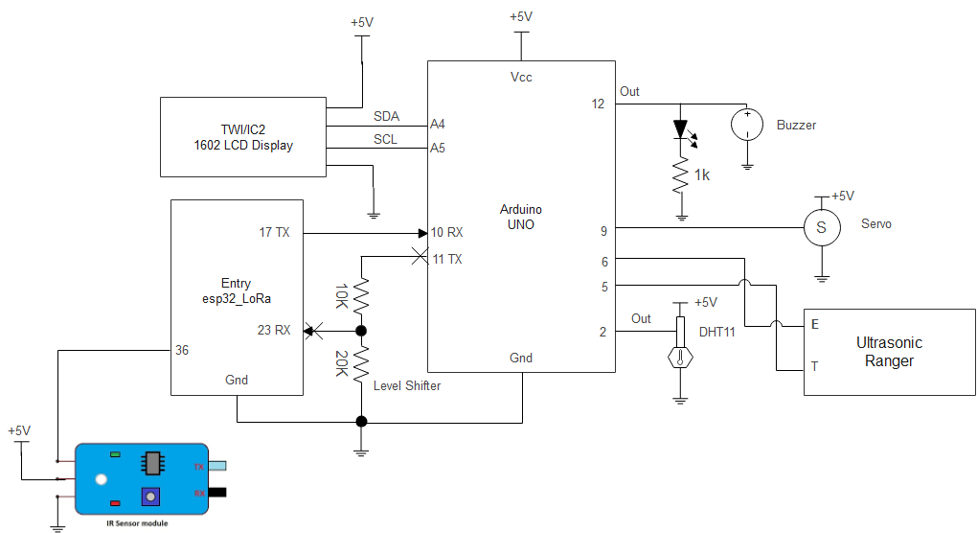
Schematic Set Up

Slide 17
Operation Flow Chart
UNO
Update Customer Count
Check & display customer Count
Customer to wait or take queue no
ESP32 Entry
ESP32 Exit
Barrier Open()
LoRa (net count)
If Count <=50
No
Display capacity exceeded
Detect customer exit (IR)
Barrier Opening Alarm (LED & Buzzer
No
Presence of Cust?
Customer exits?
Detect customer entry (IR)
No
Open barrier (Servo)
Yes
Yes
Next customer takes temp
Update net count to Cloud
via Wi-fi
See You Again (OLED)
Close barrier()
Yes
Pass temp?
No
Entry not permitted
Barrier closing Alarm (LED & Buzzer
LoRa

Slide 18
Program Flow (UNO)
UNO@Entry
Close barrier at start of program
Open barrier (servo)
Display “Please enter now” (LCD)
Ensure barrier is closed
Net customer > max capacity
Display “Crowd capacity exceeded” (LCD)
Net customer < max capacity
Display net customer in Store (LCD)
Warning Alarm (led & buzzer)
Display “Caution!!! Barrier closing” (LCD)
Display “Entry not “permitted” (LCD)
Ultrasonic sense customer within “1m”
Display “Caution “Barrier opening” (LCD)
Ensure barrier remains closed
Display “Barrier closing” (LCD)
Display “Temp is HIGH!” (LCD)
Display “Next customer, please take temp” (LCD)
Display “Entry permitted, Pls enter store” (LCD)
Warning Alarm (led & buzzer)
Temp sensor takes temp (DHT11)
If temp < 32.0
Display “Your temp is xxC” (LCD)
Else temp > 32.0
Display “Temp is xxC” (LCD)

Slide 19
Program Flow (Entry & Exit)
ESP32 @Entry
Check incoming packet from ESP32@Exit (via LoRa)
ESP32@ Exit
Check for customer entry (via IR sensor)
Check for customer exit (via IR sensor)
Check for customer entry (via IR sensor)
Update net customer count to UNO@entry (via Soft serial)
Update ESP32@Entry (via LoRa)
Update Firebase cloud via Wifi
Display “See you soon!” (OLED)
Display “Welcome!” (OLED)

Slide 20
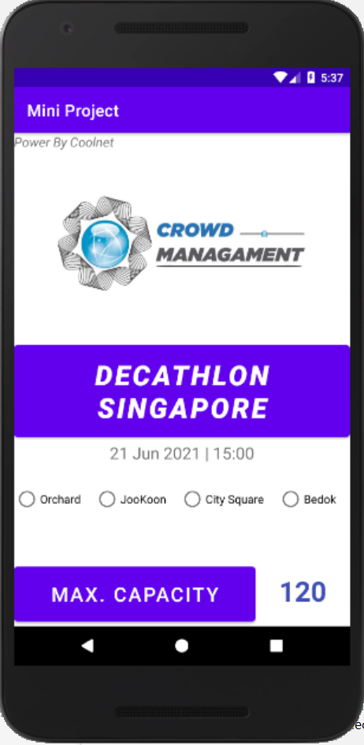
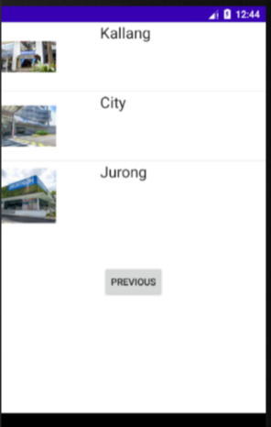
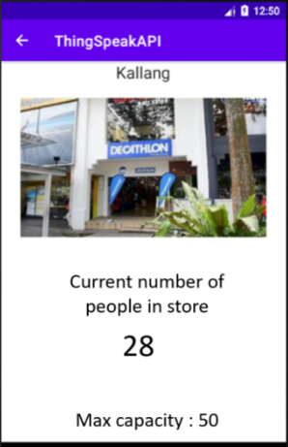
Mobile App Development
Android Mobile Application will incorporate 3 Technical criterias :
- WebView via web
- SMS or Email, Alarm or Notification via mobile phone
- Cloud Service hosted by ThinkSpeak (tbc)
Notes:
To satisfy the 3 mobile app technical contents, our project will leverage on
- WebView, SMS notification & Cloud Service.

Slide 21
Project Group Members:
1. Ng Chye Soon (Adm No.P7014423)
2. Ng Wai Cheong (Adm No: P7319713)
3. Choong Foo Chung (Adm No: P7825599) 4. Karen Loke Chia Wai (Adm No : P7075382)
School of Electrical and Electronic Engineering (EEE)
Specialist Diploma in Digital Technologies for Smart City
Notes:
Last of all, these are my project team members!

Slide 22
ThE END Thank-you

